Slide 1

Tairawhiti Rising
Growing Stronger Together
Notes:
Kia ora. My name is Lavinia and I am introducing you to my Capstone Project, a social media application called Tairawhiti Rising.

Slide 2

Tairawhiti Rising
Purpose
Problem / Opportunity
Current State / Desired State
Industry / Domain
Stakeholders
Product Description
Out of Scope
Non-Functional Requirements
Project Planning
Testing Strategy
Implementation
End to End Solution
References
Demonstration
Questions and Answers
Content Overview…
Notes:
We will cover the purpose and the problem that Tairawhiti Rising aims to solve.
We will look at current and desired state, relevant industry context and key stakeholders.
I’ll cover a detailed product description and what falls out of scope plus highlight non functional requirements.
You will see the project planning, testing and implementation as well as the end to end solution.
Finally I will share references, demonstrate the working product and cover any questions at the end.

Slide 3
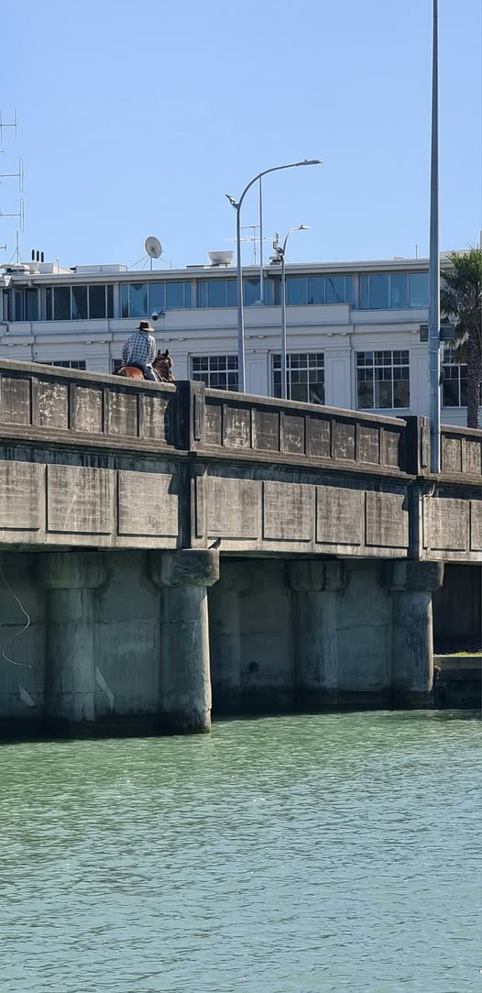
Tairawhiti Rising
PURPOSE
An online community supporting each other to strengthen family and future generations through shared learnings and community voice.
Notes:
The purpose of Tairawhiti Rising is to provide a platform for users to access support or offer support to others who may be going through similar experiences.
It is an online community supporting each other to strengthen family and future generations through shared learnings and community voice.
The insights gained by user voice and experiences can be used to inform improvements in social service design.

Slide 4

Tairawhiti Rising
PROBLEM / OPPORTUNITY
Tairawhiti Rising aims to:
Increase connection and support across community.
Insights strengthen understanding of user need and experience.
Service design and delivery is improved.
Notes:
Individuals in Tairawhiti are finding it harder to access the support that they need from agencies and service providers. Unmet needs are increasing and contributing to negative outcomes for families. In Tairawhiti 2 3rds of the population are living in hardship, that’s 33,000 people and 77% are Maori.
Current social service measurement focuses on administrative outputs. Existing survey-based methods often fail to reveal why a service succeeds or falls short.
Agencies rarely understand the true needs of the people they serve, nor do they document what matters to them.
Tairawhiti Rising aims to improve access to information, knowledge about services and strengthen understanding of user experience.
It is an opportunity for service design to reflect what matters to users, to understand where there are significant gaps in services, and for services to be improved effectively.

Slide 5

Tairawhiti Rising
CURRENT STATE
Services don’t often align with the actual needs of users.
Overloaded services.
Agency priorities are funding-driven.
DESIRED STATE?
Learnings, shared needs and collective support grows the community.
User voice and experiences inform service delivery.
Notes:
What is the current state
Social services are under pressure to meet government-mandated targets, which may not align with the actual needs of users.
Services are delivered according to system capabilities and funding, not individual needs.
This creates a self-perpetuating cycle: services appear necessary and well-utilized, while real user needs remain unmet.
The desired state that Tairawhiti Rising aims to achieve IS:
To capture authentic user experiences and perspectives through a chat forum.
Enable users to learn from one another and reduce reliance solely on the social service system.
User feedback informs system design, service improvement, and program delivery
Key learnings from projects that have attempted to collect user voice include:
What works:
User voice clearly highlights gaps and priorities and flexible frontline approaches can achieve real change.
What didn’t work: Sustained impact requires leadership by-in, funding, and contract alignment. Disconnects between Central and local government layers can block progress.
These insights show the importance of a structured, sustainable approach to capturing user experience—one that can influence system design and service delivery effectively.
Tairawhiti Rising aims to remove the need for third party collection of user voice and experience and gives individuals the opportunity to share their own voice and the impact their experience has on their lives.

Slide 6

Tairawhiti Rising
Social services (government agencies, NGOs, community support programs).
Value Chain
Funding, Program design & delivery, User engagement, Reporting, Policy review.
Key Concepts
User experience, service quality vs. quantity, co-design, commissioning .
Relevance to Other Industries
Any sector can benefit from learning from users.
Industry / Domain
Notes:
The social service sector includes government agencies, Non-Government Organisations, and community supports.
The Government funds programs, NGOs deliver services, authentic user feedback is inconsistently captured, Reporting prioritizes attendance over outcomes and Policy decisions often lack real user insight.
Key Concepts
Authentic user feedback (whānau voice) informs better service design.
Government contracts drive outputs, not user-centered outcomes.
Outcomes-based evaluation and co-design are critical to meet real needs.
Tairawhiti Rising provides a platform to consistently capture user experiences and inform service improvements, focusing on what truly matters.
The benefits of applying this approach include:
Resources are focused on what is truly needed.
Industries like healthcare, education, local government services, and even commercial service providers can learn from these practices to improve responsiveness and user satisfaction.

Slide 7

Tairawhiti Rising
STAKEHOLDERS
Community - Tairāwhiti residents
Autonomy to share their experiences and needs; expect privacy and responsive services; want to see real improvements.
Service Providers - Non-government and community organizations
Use insights to improve service delivery, support funding applications, and adapt programs to actual user needs.
Government Agencies - local and central
Allocate resources efficiently, identify service gaps and areas for improvement.
Notes:
Stakeholders are the Tairawhiti Community, Service Providers and Government Agencies.
The software gives the community the autonomy to share their experiences and need, they expect privacy and responsive services.
Service Providers want to use insights to improve service delivery and support funding applications.
Government Agencies want true user voice to identify gaps and areas for improvement.

Slide 8

Tairawhiti Rising
PRODUCT DESCRIPTION
Architecture Diagram
User Stories
User Flow
Database Model
UI Design Concept
Design
Out of Scope
Non-Functional Requirements
Notes:
Tairawhiti Rising consists of four main components:
Landing Page
Community Chat
Database
The fourth component is the Dashboard which is part of future scope

Slide 9
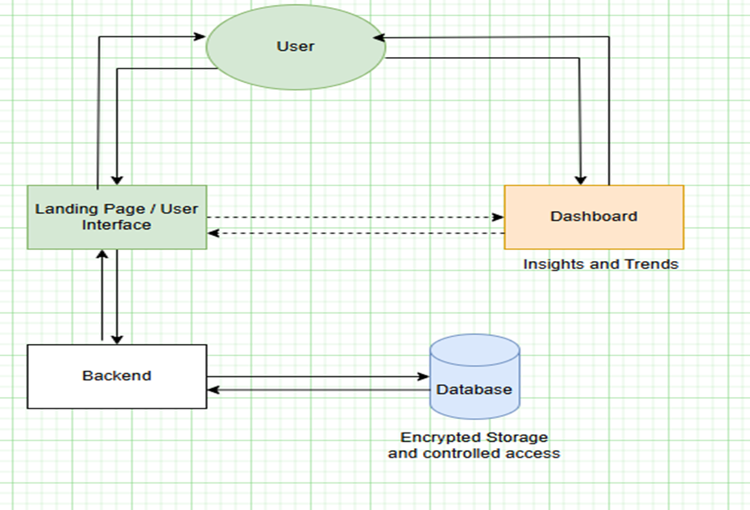
Tairawhiti Rising
Architecture Diagram
Notes:
Shows user interacting with frontend – landing page and dashboard – data is requested and retrieved from backend and returned to user.

Slide 10
Tairawhiti Rising
Making a Post | User can post information or ask questions, including context around their needs. | HIGH | Enables sharing and learning from user experiences.
Making a Comment | User can comment on posts to provide advice or share experiences | HIGH | Encourages interaction and support
User Stories
User Story Title | User Story Description | Priority | Additional Notes
Landing Page | User arrives at the landing page, can sign up or login to access the chat forum and dashboard. | HIGH | Simple navigation, clear purpose and usage instructions.
Creating an account | User can sign up to register, contribute, and receive support. Assigned a unique ID – anonymous BUT unique based on e-mail address. | HIGH | Required: Username Email address Password (*encryption) Date of birth
Logging in | User can sign in using e-mail and password to access chat forum. | HIGH | Logs user activity by unique id.
Editing / Deleting | User can edit and/or delete their own posts and comments. | HIGH | Provides User control over their content.
Logging feedback | User can submit faults or suggestions with the feedback button. | Low | Supports continuous Improvement.
Logging out | User can log out, stopping access to forum and dashboard. | HIGH | Secures user sessions.
Chat Forum Display | User can see the chat forum after login, can post queries and advice or comment on posts. | HIGH | Main interaction area.
Notes:
User stories focus on user interaction with landing page, logging in, signing up and posting or commenting in the chat forum.

Slide 11
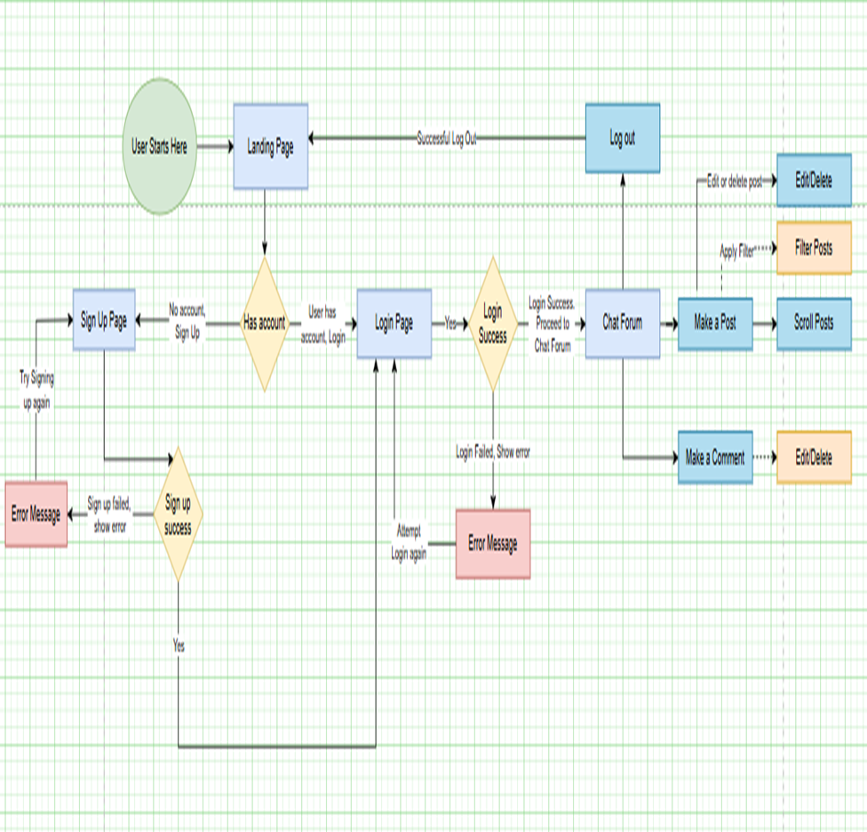
Tairawhiti Rising
User Flow
Notes:
The user flow shows the flow from access to Tairawhiti Rising Landing Page, if no account, sign up, if there is an account, sign in. Upon sign in the user is directed to the chat forum where they can make a post, comment on a post, edit or delete both posts and comments. And finally log out.

Slide 12
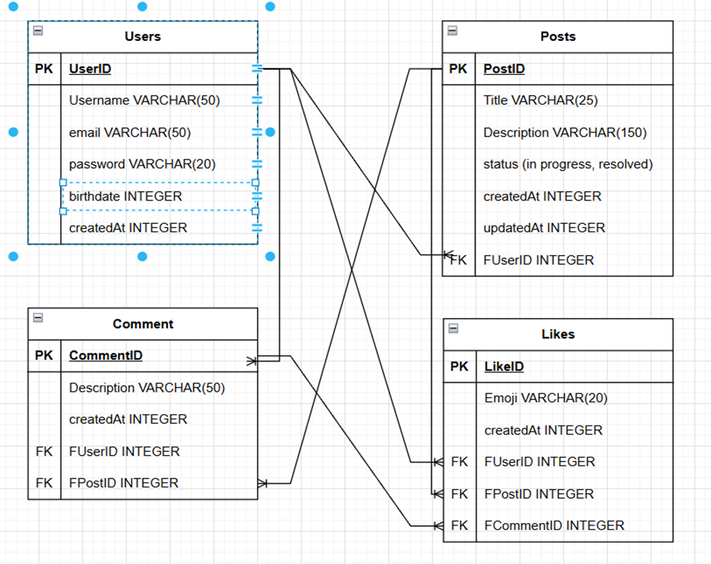
Tairawhiti Rising
Database Model
Notes:
Physical model – showing primary key and foreign keys as well as constraints and relationships

Slide 13
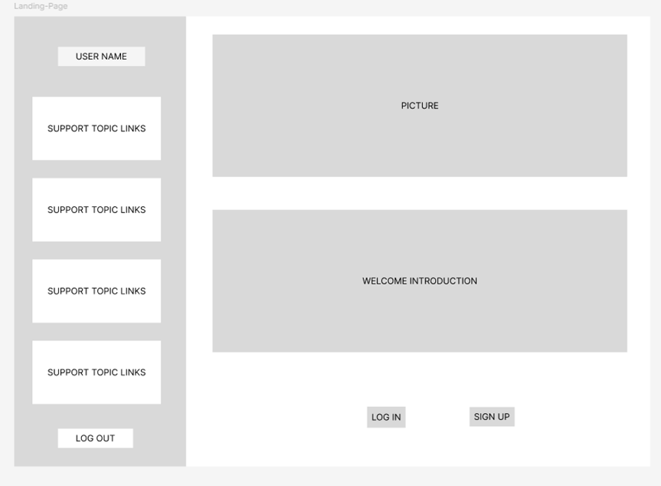
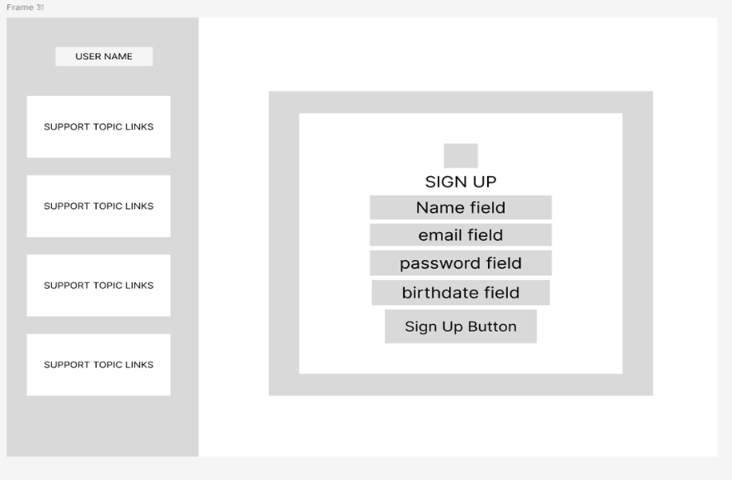
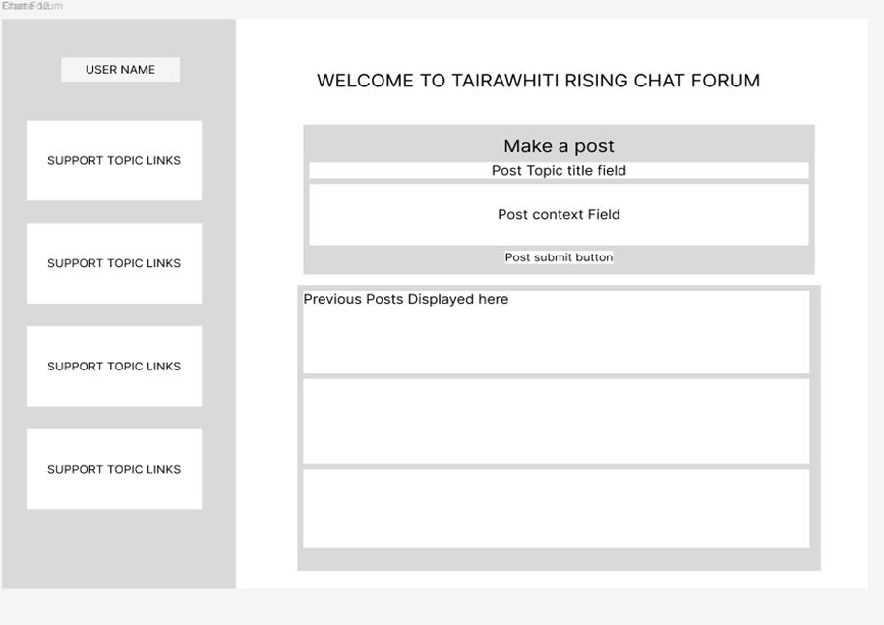
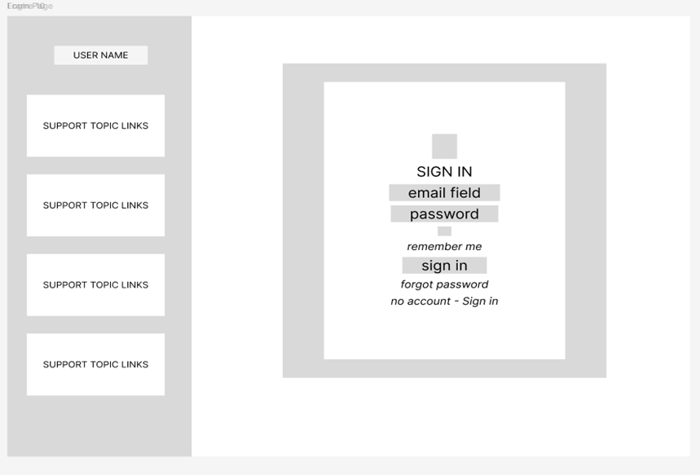
UI Design Concept and Wireframe Design
Tairawhiti Rising
Notes:
Wireframe design in Figma

Slide 14
Tairawhiti Rising
UI Design Concept and Wireframe Design
Notes:
Wireframe Designs for landing-page, sign-up, sign-in and chat forum. All pages have the sidebar which allows access to log out and see their username. There are also placeholder cards for support topic links – these will be based on user data gained from the chat forum – dependant on the most frequent topics – will provide links to relevant information.

Slide 15
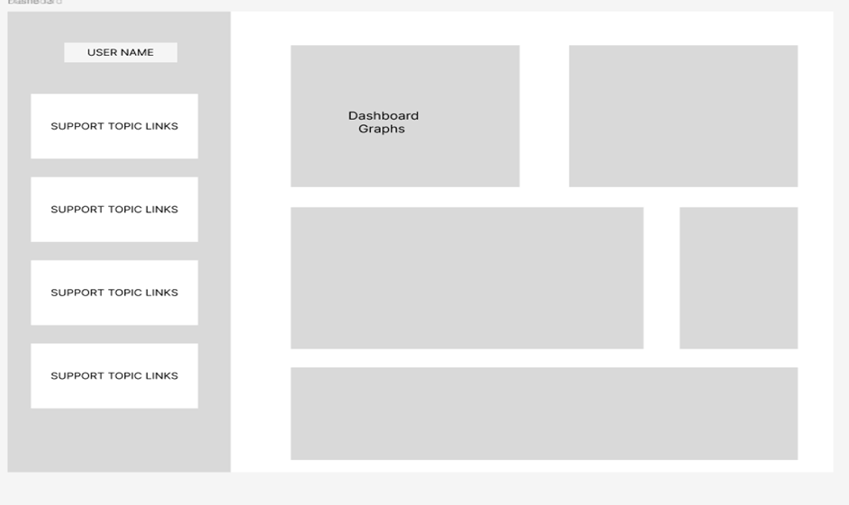
Tairawhiti Rising
Out of Scope
Dashboard Functionality
Profile Personalisation
Security / Privacy Functions
Additional features - search filters, guidelines, templates and ability to upload documents
Notes:
The features that are out of scope?
Dashboard functionality & Analytics
Security - Password hashing, sessions, tokens
Search filters - Based on user trends e.g. high levels of budgeting queries, more information provided about budgeting.
User Feedback functionality
Administrator functions.

Slide 16
Tairawhiti Rising
Non-Functional Requirements
User Id for anonymity
Caters to a wide range of technical abilities
Quick response time
Designed for scalability and future feature addition
Notes:
The key security requirements include:
Storage of personal details.
User Id to maintain anonymity.
Restricted access to personal data.
Peak transactions - but load testing and performance testing will determine maximum users and transaction capacity - 200 requests per minute initially,
The software should be intuitive and accessible to users with a wide range of technical abilities, responding quickly to user requests, reliable to maintain useability, satisfaction and user confidence for increased use.
Due to simple architecture, minimal downtime is expected.
External Links may fail occasionally, due to external management of those sites.
For maintainability,
Backend uses MVC (model view controller structure for separation of concerns).
Frontend utilises reuseable components (e.g. custom hooks, cards)
Code separated according to each component to simplify maintenance.
Designed for scalability and future feature addition.

Slide 17
Tairawhiti
Rising
Project Planning
Notes:
I started design and considerations for the project on 10 March 2026. The goal was to develop a responsive interface, full CRUD database functionality and develop a system with user authentication. I completed the backend, including database design and API functionality, as well as frontend, including the landing page, login and registration features. Testing was carried out for key components. The dashboard was partially completed but moved out of scope to prioritise core functionality. The main system is fully working.

Slide 18

Tairawhiti Rising
References:
Code and README file is here:
https://github.com/lavip120-a11y/CapStoneProject2026.git
Resources Used:
Git – repository for code
Visual Studio Code – terminal
ThunderClient - testing
React
Material UI – templates and components
CSS
MySQL
Sequelise
Nodejs, nodemon
Express
Axios library
A full list of resources can be viewed in package.json
End to end solution..
Captures User Voice
Enables knowledge sharing
Notes:
The solution was designed as an end to end social media platform that effectively
Captures user voice
Enables knowledge sharing within the community
Supports service improvement through user feedback
With the current version meeting its core objectives, future enhancements include
Dashboard functionality for analytics and reporting,
User Feedback, guide
Additional UI work for clean, simple user interaction, navigation.
And regular testing will ensure the platform continues to evolve alongside the communities needs.
You can see the reference to my github repository and resources used for the project.

Slide 19
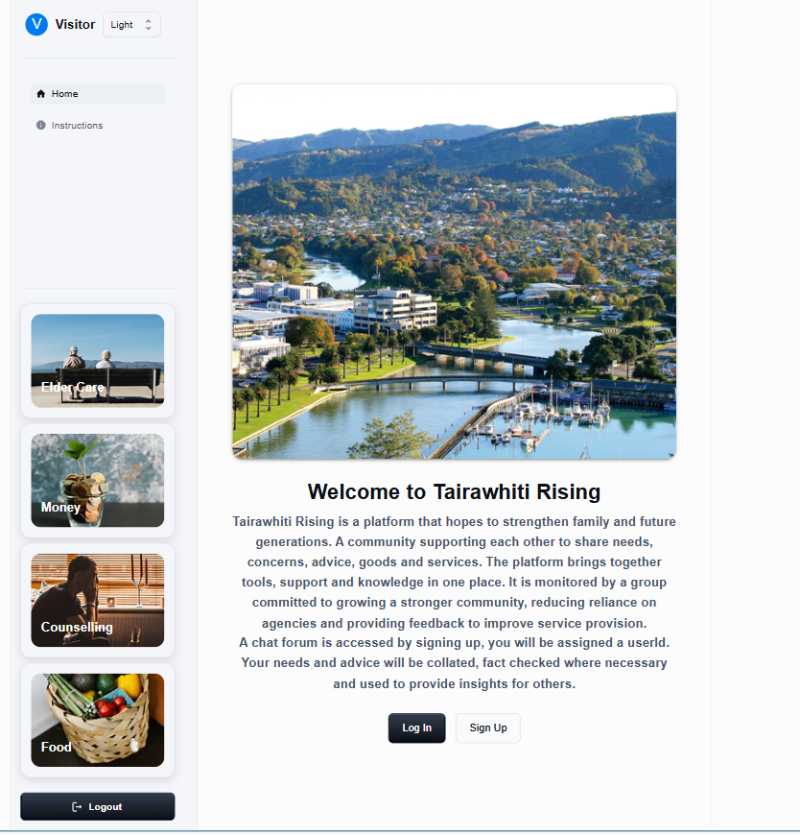
Tairawhiti Rising
DEMONSTRATION
Landing Page
Links
Login
Sign-Up
Chat-Forum
Database
Tables / schema
Notes:
Landing Page - Welcome, providing introduction to Tairawhiti Rising
User sees clear options to log in or sign up.
Content Sidebar: Username, Logout, Support topic links – based on user interaction from chat forum these will provide links to additional information and external sites.
Sign-Up Page: For new users to register. This is where the unique user identifier for tracking the user in the database is allocated.
Create Account
Users can submit required fields: username, email, password, birthdate.
Error messages are shown if constraints are not met.
Password is stored.
Unique ID is assigned.
Registered users can access the chat forum.
User directs you to login page.
Log In
Users can log in with correct email/password.
Error messages are shown if credentials are incorrect.
User directed to chat forum.
Community Chat
Users can Make Post / Comment
Users can enter post/comment content.
Validation ensures content is not empty.
Submitted content appears in forum immediately.
Users can edit or delete their own posts/comments.
Database
Stores all user information and posts.
Ensures data is secure, structured, and retrievable for future analysis.

Slide 20

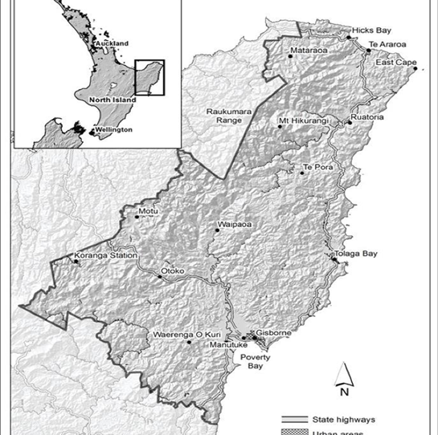
Tairawhiti Rising
Questions and Answers
Notes:
Testing Strategy
What were steps undertaken to achieve product quality?
Design Validation checked using low fi design in Figma, use cases and database logical and physical models.
Testing using Thunder client, console.log and testing through ongoing manual testing of the application.
Each feature of the application tested?
Database API testing using Thunder client to test CRUD operations for posts comments user registration and login.
Manual user testing – walked through all user flows to ensure functionality.
Browser Inspect to check responsivity, work through console errors, check styling.
How did you handle edge cases?
Attempted actions such as:
Submitting empty posts or comments
Duplicate registrations
Editing/deleting posts not belonging to the user
Used console logs and browser inspect tools to monitor errors and validate handling.

